Slide 1


Noida Institute of Engineering and Technology, Greater Noida
WEB DEVELOPMENT USING MEAN STACK
Unit: V
Connecting Angular js with MongoDB
Ritesh Kumar Singh
(Asst. Professor)
CSE Department
Course Details (B. Tech. 6th Sem)

Slide 2
Faculty Introduction
Name | Ritesh Kumar Singh
Qualification | Diploma, B.Tech., M. Tech., PhD. Pursuing
Designation | Assistant Professor
Department | Computer Science & Engineering
Total Experience | 5 years
NIET Experience | 4.5 years
Subject Taught | Web development using python with Django, Web Development using Mean Stack, Problem Solving using Advance Python, Problem Solving using Python, Programming for Problem Solving using C, Database Management System.

Slide 3
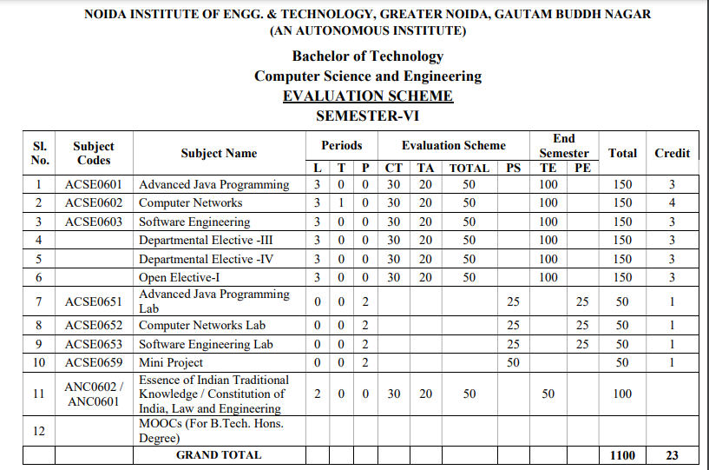
Evaluation Scheme

Slide 4
Syllabus
UNIT-I: Introduction to Nodejs
Installing Nodejs, Node in-built packages (buffer, fs, http, os, path, util, url)Node.js modules, File System Module, Json data, Http Server and Client, Error handling with appropriate HTTP, Callback function, asynchronous programing REST API’s(GET, POST PUT, DELETE UPDATE), Graph, Promises, Promise Chaining, Introduction to template engine (EJS).

Slide 5
Syllabus
UNIT-II: Express Framework
Configuring Express, Postman configuration, Environment Variables, Routing, Defining pug templates, HTTP method of Express, URL binding, middleware function, Serving static files, Express sessions, REST full API’s, FORM data in Express, document modeling with Mongoose.

Slide 6
Syllabus
UNIT-III: Basics of Angular js
Typescript, Setup and installation, Power of Types , Functions Function as types Optional and default parameters, Arrow functions, Function overloading, Access modifiers, Getters and setters, Read-only & static, Abstract classes, Interfaces, Extending and Implementing Interface, Import and Export modules.

Slide 7
Syllabus
UNIT-IV: Building Single Page App with Angular js
MVC Architecture, One-way and Two-way data binding, AngularJS Expressions, AngularJS Controllers, AngularJS Modules, adding controller to a module, Component, Dependency Injection, Filters, Tables, AngularJS Forms and Forms validation, Select using ng-option, AngularJS AJAX.

Slide 8
Syllabus
UNIT-V: Connecting Angular js with MongoDB
Environment Setup of Mongo dB , data modeling ,The current SQL/NoSQL landscape, Create collection in Mongo dB, CRUD Operations in MongoDB. Mongo's feature set, Introduction to Mongoose, understanding mongoose schemas and datatypes, Connecting Angular with mongo dB using API.

Slide 9
Branch Wise Application
1. Real time web analytics
2. Digital Advertising
3. E-Commerce
4. Publishing
5. Massively Multiplayer Online Games
6. Backend Services and Messaging
7. Project Management & Collaboration
8. Real time Monitoring Services
9.Live Charting and Graphing
10. Group and Private Chat

Slide 10
Course Objective
In this semester, the students will
Study how to design and build static as well as dynamic webpages and interactive web applications
Students examine advanced topics like Angular, nodejs, Mongodb for web applications.
Also examine Express framework for interactive web applications that use rich user interfaces .

Slide 11
Course Outcomes (COs)
At the end of course, the student will be able to:
CO1 : Explain, analyze and apply the role of server-side scripting language like Nodejs .
CO2 : Demonstrate Express framework to design and implement dynamic web pages.
CO3 : Apply the knowledge of Typescript that are vital in understanding angular js.
CO4 : Analyze build and develop single page application using client-side programming.
CO5 : Understand the impact of web designing by database connectivity with Mongodb

Slide 12
Program Outcomes (POs)
Engineering Graduates will be able to:
PO1 : Engineering Knowledge
PO2 : Problem Analysis
PO3 : Design/Development of solutions
PO4 : Conduct Investigations of complex problems
PO5 : Modern tool usage
PO6 : The engineer and society

Slide 13
Program Outcomes (POs)
Engineering Graduates will be able to:
PO7 : Environment and sustainability
PO8 : Ethics
PO9 : Individual and teamwork
PO10 : Communication
PO11 : Project management and finance
PO12 : Life-long learning

Slide 14

COs - POs Mapping
CO.K | PO1 | PO2 | PO3 | PO4 | PO5 | PO6 | PO7 | PO8 | PO9 | PO10 | PO11 | PO12
CO1 | 2 | 2 | 2 | 3 | 3 | - | - | - | - | - | - | -
CO2 | 3 | 2 | 3 | 2 | 3 | - | - | - | - | - | - | -
CO3 | 3 | 2 | 3 | 2 | 3 | - | - | - | - | - | - | -
CO4 | 3 | 2 | 3 | 2 | 3 | - | - | - | - | - | - | -
CO5 | 3 | 2 | 3 | 3 | 3 | - | - | - | - | - | - | -
AVG | 2.8 | 2.0 | 2.8 | 2.4 | 3.0 | - | - | - | - | - | - | -

Slide 15
Program Specific Outcomes(PSOs)
S. No. | Program Specific Outcomes (PSO) | PSO Description
1 | PSO1 | Understand to shows relationships and interactions between classes or objects of a pattern.
2 | PSO2 | Study to speed up the development process by providing well-tested, proven development
3 | PSO3 | Select a specific design pattern for the solution of a given design problem
4 | PSO4 | Create a catalogue entry for a simple design pattern whose purpose and application is understood.

Slide 16
COs - PSOs Mapping
CO.K | PSO1 | PSO2 | PSO3 | PSO4
CO1 | 3 | - | - | -
CO2 | 3 | 3 | - | -
CO3 | 3 | 3 | - | -
CO4 | 3 | 3 | - | -
CO5 | 3 | 3 | - | -

Slide 17
Program Educational Objectives (PEOs)
Program Educational Objectives (PEOs) | PEOs Description
PEOs | To have an excellent scientific and engineering breadth so as to comprehend, analyze, design and provide sustainable solutions for real-life problems using state-of-the-art technologies.
PEOs | To have a successful career in industries, to pursue higher studies or to support entrepreneurial endeavors and to face the global challenges.
PEOs | To have an effective communication skills, professional attitude, ethical values and a desire to learn specific knowledge in emerging trends, technologies for research, innovation and product development and contribution to society.
PEOs | To have life-long learning for up-skilling and re-skilling for successful professional career as engineer, scientist, entrepreneur and bureaucrat for betterment of society.

Slide 18
Result Analysis(Department Result & Subject Result & Individual result
Name of the faculty | Subject code | Result % of clear passed
Mr. Rahul Kumar | ACSE0614

Slide 19
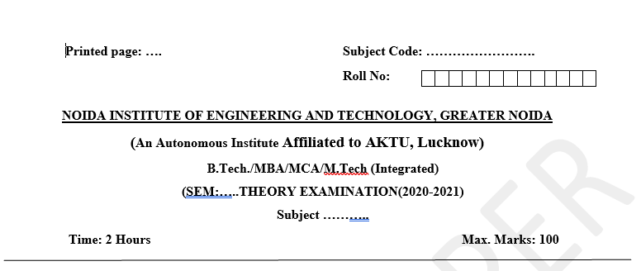
Pattern of Online External Exam Question Paper (100 marks)

Slide 20
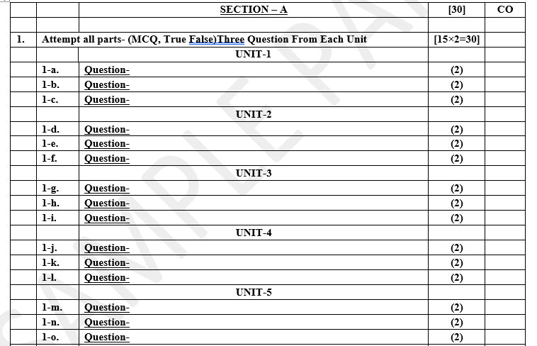
Pattern of Online External Exam Question Paper (100 marks)

Slide 21
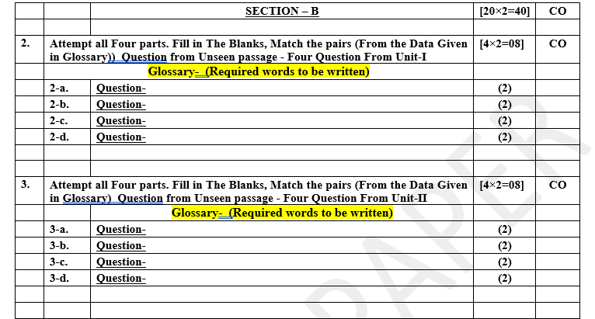
Pattern of Online External Exam Question Paper (100 marks)

Slide 22
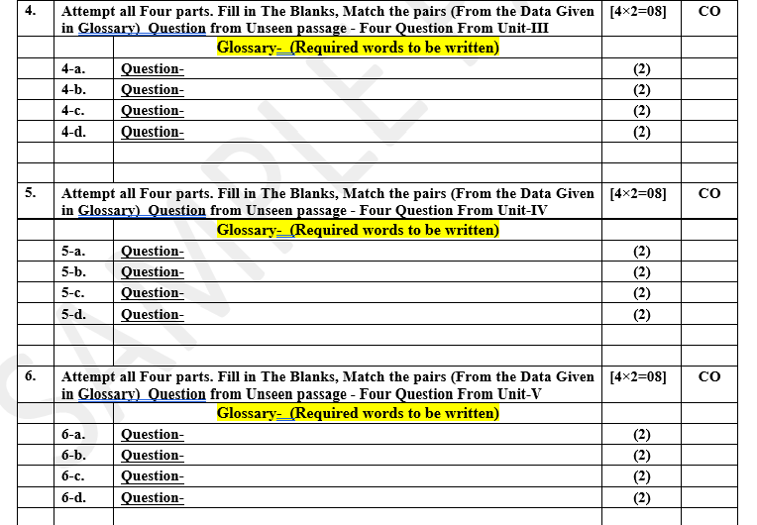
Pattern of Online External Exam Question Paper (100 marks)

Slide 23

Pattern of Online External Exam Question Paper (100 marks)

Slide 24
Prerequisite / Recap
Student should have knowledge of Web technology and terminology.
Knowledge of HTML ,CSS and Java Script required .
knowledge of Programing language such as C/C++/Python etc.
Good problem solving Skill .

Slide 25
Brief Introduction about the Subject with videos
YouTube /Other Video Links
https://youtu.be/BLl32FvcdVM
https://youtu.be/v9ejT8FO-7I?list=PLrhzvIcii6GNjpARdnO4ueTUAVR9eMBpc
https://youtu.be/VGLjQuEQgkI?list=PLt4nG7RVVk1h9lxOYSOGI9pcP3I5oblbx

Slide 26
Unit V Content
Environment Setup of Mongo dB
data modeling ,The current SQL/NoSQL landscape, Create collection in Mongo dB,
CRUD Operations in MongoDB.
Mongo's feature set, Introduction to Mongoose, understanding mongoose schemas and datatypes

Slide 27
Unit IV Objective
In Unit IV, the students will be able to Understand
Definitions of MVC and concepts of MVC.
How one way and two way data binding is done.
Angular JS Introduction ,
Angular JS Expressions ,Controllers,Modules.
How we can add Controller to Model.
Depending Injuctions is done.
Angular JS forms validations
Using AJAX calls

Slide 28
Environment Setup of Mongodb
Step 1: Download The Installer
Go to the download page at
https://www.mongodb.com/try/download/community
Choose your OS and your desired MongoDB version.
Click Download.
Step 2: Run The MongoDB Installer(a .msi file)
Go to your ‘Downloads’ folder.
Click on the installer.
Follow the instructions.
After completing the installation process, you will find MongoDB software in your C drive. To view it, go to

Slide 29
Environment Setup of Mongodb
Cont………
C:Program FilesMongoDBServer{version}bin.
However, you would notice the presence of any executable alongside mongo – mongod. Mongod is a daemon process that runs in the background. It handles database processes like accessing, retrieval, and updates.
If you try using MongoDB right away, you might have to specify a directory structure every time you need to use it. To avoid this you need to specify an environment variable for MongoDB, which leads us to step 3.

Slide 30
Environment Setup of Mongodb
Cont………
Step 3: Specify An Environment Variable
Go to your system settings or type “Advanced system settings” in the search bar.
Click ‘Environment Variables’ under ‘Advanced’.
Click ‘New’ to create an environment variable.
Select the ‘Path’ variable and click on ‘Edit’.
Change the environment variable to
C:Program FilesMongoDBServer{version}bin. Where version is the MongoDB version you downloaded.
Click Save.
If you run the mongod command now, you would get a log error when the mongod service doesn’t find a data directory.

Slide 31
Environment Setup of Mongodb
Cont………
Step 4: Configure a Data Directory For All MongoDB Files
To configure a data directory for MongoDB, create a directory called ‘MongoDBFiles’ with subdirectories ‘/data/db’. You can do this manually or by typing the command below in the terminal.
> mkdir -p MongoDBFiles/data/db
Make sure you are in the C:/ directory before doing this.
After doing that, type mongodb –dbpath “C:/MongoDBFiles/data/db”.
This command will set the directory to store all MongoDB operations on your computer.

Slide 32
Environment Setup of Mongodb
Cont………
Step 5: Run mongo
Now that you’ve configured MongoDB, run ‘mongod’ in the terminal to confirm if it works. The server should be on port 27017(MongoDB’s default port) which you can connect to. However, to connect and use MongoDB, you have to run the mongod server first.
Step 6: Test Your Installation
To confirm your installation, run ‘mongo’ in the terminal. You should see a command shell similar to the command prompt that allows you to enter commands. Type ‘show dbs’ to see the list of the existing databases.

Slide 33
Data modeling in Mongodb
Def:-Data modeling is the process of creating a clean data model of how you will store data in a database. Data models also describe how the data is related. The goal of data modeling is to identify all the data components of a system, how they are connected, and what are the best ways to represent these relationships.
Data modeling is done at the application level. Data models consist of the following components:
Entity—an independent object that is also a logical component in the system. Entities can be categorized into tangible and intangible. Tangible entities, such as books, exist in the real world, while intangible entities, such as book loans, don’t have a physical form. In document databases, each document is an entity. In tabular databases, each row is an entity.

Slide 34
Data modeling in Mongodb
Entity types—the categories used to group entities. For example, the book entity with the title “Alice in Wonderland” belongs to the entity type “book.”
Attributes—the characteristics of an entity. For example, the entity “book” has the attributes ISBN (String) and title (String).
Relationships—define the connections between the entities. For example, one user can borrow many books at a time. The relationship between the entities "users" and "books" is one to many.

Slide 35
Advantages of Data modeling
There are several advantages of data modeling:
Ensures better database planning, design, and implementation, leading to improved application performance.
Promotes faster application development through easier object mapping.
Better discovery, standardization, and documentation of multiple data sources.
Allows organizations to think of long-term solutions and model data considering not only current projects, but also future requirements of the application.

Slide 36
Types of data models
Three following types.
Conceptual Data Model: The conceptual data model explains what the system should contain with regard to data and how it is related. This model is usually built with the help of the stakeholders. It represents the application’s business logic and is often used as the basis for one or more of the following models.
Logical Data Model: The logical data model will describe how the data will be structured. In this model, the relationship between the entities is established at a high level. You will also list the attributes for the entities represented in the model.

Slide 37
Types of data models
Physical Data Model: The physical data model represents how the data will be stored in a specific database management system (DBMS). With this model, you would establish your primary and secondary keys in a relational database or decide whether to embed or link your data in a document database such as MongoDB. You will also establish the data types for each of your fields. This will provide you with your database schema.

Slide 38
Data modeling process
1.Gather requirements
The first step to a data modeling process is to gather all the requirements for your application. This step will provide you with the underlying data structure that you will need to review. Analyze not only the data objects, but also the size of the data and the operations that will be performed on that data. This step will be done with the help of domain experts. At the end of this first step, you should have the necessary information to draft your conceptual data model.

Slide 39
Data modeling process
2.Understand relationships between entities
The next step is to understand the relationship between the various entities that make up your whole data model. Try to think about how the objects would be related (one to one, one to many, or many to many) and the attributes you would use to describe these objects. This step will provide you with your logical data model.

Slide 40
Data modeling process
3.Identify the data structure
Finally, you can start thinking about the actual data that you will store in the database. At this point, you will try to identify unique keys and field types. The way you model your data will depend highly on the type of DBMS you will be using. If you are using a relational database, you might start thinking about normalizing your data while you would think about embedding related information in a document database.
At the end of this step, you can produce a physical data model representing your initial database.

Slide 41
Data modeling process
4.Apply design patterns
Patterns make data modeling more efficient and effective. With design patterns, it’s easier to accommodate changes in application requirements and structure. Some common patterns are:
The schema versioning pattern.
The bucket pattern.
The computed pattern.
The tree pattern.

Slide 42
SQl vs NoSQL in the changing IT landscape
Since the dawn of computing, we’ve been accumulating huge amounts of data. Its dissemination or transmission is emerging as one of the most critical aspects in almost all applications. The performance and reliability of computer hardware has undergone exponential increase. But how does this impact the way we work with data?
While network speeds are growing rapidly, enabling faster data transfers, memory (RAM) and storage (HDD, SSD) are becoming cheaper along with rapid speed jumps. We need to highlight and compare the improvements in personal computing and in the corporate space for people to relate, right?
For instance, home broadbands are now capable of 1Gbps speed and home-bound ethernet switches can operate at 2.5Gbps - most of us use laptops that have 1Gbps ethernet ports on them, but the same on the corporate side (AWS for example) is as high as 25Gbps!
Priti Kumari WEB DEVELOPMENT USING MEAN STACK Unit V

Slide 43
SQl vs NoSQL in the changing IT landscape
Also take storage, for example, the latest MacBook Pro’s have SSDs operating at 7GBps, the same that the PS5 recommends. Most current laptops have SSDs operating at 3-4GBps. Gone are the days when HDDs were mainstream operating at ~150MBps
Going the (No)SQL way
The database universe is undergoing a transformation with the legacy RDBMS being reimagined for a distributed world. So, what kind of database will you primarily use to store your data? In the relational (SQL) Vs. non-relational (NoSQL) debate, the determining factors are your data structure, ability to query data, and your scalability needs.

Slide 44
SQl vs NoSQL in the changing IT landscape
Even a few years back, app developers needed to know SQL since, regardless of the data model/format used within the application, they would eventually need to store to an RDBMS and then access the data using queries. And, you had to spend time on how you structured the query, as it impacted the performance of the query and the database.
Although relational databases have always been the go-to for storing data and they continue to be a viable option, NoSQL has evolved as the preferred choice in many use cases in terms of scalability and performance. Formerly robust ACID transactional capabilities were the domain of RDBMS, however MongoDB, one of the examples of NoSQL upping the game, now provides the capability, making NoSQL even more enticing to switch to.

Slide 45
Create Collection in Mongodb
db.createCollection(name, options)
Creates a new collection or view. For views, see also db.createView().
Because MongoDB creates a collection implicitly when the collection is first referenced in a command, this method is used primarily for creating new collections that use specific options. For example, you use db.createCollection() to create a:
Capped collection.
Clustered collection.
New collection that uses document validation.
db.createCollection() is a wrapper around the database command create.

Slide 46
Create Collection in Mongodb
Basic syntax of createCollection() method without options is as follows −
>use test
switched to db test
>db.createCollection("mycollection")
{ "ok" : 1 }
>
check the created collection by using the command show collections.
>show collections
mycollection
system.indexes

Slide 47
MongoDB CRUD Operations
MongoDB documents are modified by connecting to a server, querying the proper documents, and then changing the setting properties before sending the data back to the database to be updated. CRUD is data-oriented, and it’s standardized according to HTTP action verbs.
When it comes to the individual CRUD operations:
The Create operation is used to insert new documents in the MongoDB database.
The Read operation is used to query a document in the database.
The Update operation is used to modify existing documents in the database.
The Delete operation is used to remove documents in the database.

Slide 48
MongoDB CRUD Operations cont…
1.Create Operations
For MongoDB CRUD, if the specified collection doesn’t exist, the create operation will create the collection when it’s executed. Create operations in MongoDB target a single collection, not multiple collections. Insert operations in MongoDB are atomic on a single document level.
MongoDB provides two different create operations that you can use to insert documents into a collection:
db.collection.insertOne()
db.collection.insertMany()

Slide 49
MongoDB CRUD Operations cont…
2.Read Operations
The read operations allow you to supply special query filters and criteria that let you specify which documents you want. The MongoDB documentation contains more information on the available query filters. Query modifiers may also be used to change how many results are returned.
MongoDB has two methods of reading documents from a collection:
db.collection.find()
db.collection.findOne()

Slide 50
MongoDB CRUD Operations cont…
3.Update Operations
Like create operations, update operations operate on a single collection, and they are atomic at a single document level. An update operation takes filters and criteria to select the documents you want to update.
You should be careful when updating documents, as updates are permanent and can’t be rolled back. This applies to delete operations as well.
For MongoDB CRUD, there are three different methods of updating documents:
db.collection.updateOne()
db.collection.updateMany()
db.collection.replaceOne()

Slide 51
MongoDB CRUD Operations cont…
4.Delete Operations
Delete operations operate on a single collection, like update and create operations. Delete operations are also atomic for a single document. You can provide delete operations with filters and criteria in order to specify which documents you would like to delete from a collection. The filter options rely on the same syntax that read operations utilize.
MongoDB has two different methods of deleting records from a collection:
db.collection.deleteOne()
db.collection.deleteMany()

Slide 52
Mongo’s Features set
Schema-less Database: It is the great feature provided by the MongoDB. A Schema-less database means one collection can hold different types of documents in it. Or in other words, in the MongoDB database, a single collection can hold multiple documents and these documents may consist of the different numbers of fields, content, and size. It is not necessary that the one document is similar to another document like in the relational databases. Due to this cool feature, MongoDB provides great flexibility to databases.
Document Oriented: In MongoDB, all the data stored in the documents instead of tables like in RDBMS. In these documents, the data is stored in fields(key-value pair) instead of rows and columns which make the data much more flexible in comparison to RDBMS. And each document contains its unique object id.

Slide 53
Mongo’s Features set Cont......
Indexing: In MongoDB database, every field in the documents is indexed with primary and secondary indices this makes easier and takes less time to get or search data from the pool of the data. If the data is not indexed, then database search each document with the specified query which takes lots of time and not so efficient.
Scalability: MongoDB provides horizontal scalability with the help of sharding. Sharding means to distribute data on multiple servers, here a large amount of data is partitioned into data chunks using the shard key, and these data chunks are evenly distributed across shards that reside across many physical servers. It will also add new machines to a running database.

Slide 54
Mongo’s Features set Cont......
Replication: MongoDB provides high availability and redundancy with the help of replication, it creates multiple copies of the data and sends these copies to a different server so that if one server fails, then the data is retrieved from another server.
Aggregation: It allows to perform operations on the grouped data and get a single result or computed result. It is similar to the SQL GROUPBY clause. It provides three different aggregations i.e, aggregation pipeline, map-reduce function, and single-purpose aggregation methods
High Performance: The performance of MongoDB is very high and data persistence as compared to another database due to its features like scalability, indexing, replication, etc.

Slide 55
Introduction of Mongoose
Mongoose is an Object Data Modeling (ODM) library for MongoDB and Node.js. It manages relationships between data, provides schema validation, and is used to translate between objects in code and the representation of those objects in MongoDB.
MongoDB is a schema-less NoSQL document database. It means you can store JSON documents in it, and the structure of these documents can vary as it is not enforced like SQL databases. This is one of the advantages of using NoSQL as it speeds up application development and reduces the complexity of deployments.

Slide 56
Mongoose schema
A schema is a JSON object that defines the structure and contents of your data. You can use Atlas App Services' BSON schemas, which extend the JSON Schema standard, to define your application's data model and validate documents whenever they're created, changed, or deleted.
Schemas represent types of data rather than specific values. App Services supports many built-in schema types. These include primitives, like strings and numbers, as well as structural types, like objects and arrays, which you can combine to create schemas that represent custom object types.

Slide 57
Mongoose schema
Cont...
The following Schema Types are permitted:
Array
Boolean
Buffer
Date
Mixed (A generic / flexible data type)
Number
ObjectId
String

Slide 58
Topic Link ( YouTube & NPTEL Video Links)
YouTube /other Video Links
https://www.youtube.com/watch?v=zKkUN-mJtPQ&list=PL6n9fhu94yhWKHkcL7RJmmXyxkuFB3KSlhttps://youtu.be/v9ejT8FO-7I?list=PLrhzvIcii6GNjpARdnO4ueTUAVR9eMBpc
https://www.youtube.com/watch?v=0LhBvp8qpro

Slide 59
MCQ (End of Unit)
1 Primary unit of data modeling in MongoDb
Tables
Row
Documents
All of the above
2. Syntax for creating a new collection with a specific name in MongoDB
db.newCollection("collectionName")
db.addCollection("collectionName“)
Both A and B
None of these

Slide 60
MCQ (End of Unit)
3 Key feature of MongoDB
Transactions
Stored procedures
Joins
All of the above
4 Options you can specify when creating a new collection in MongoDB
The maximum size of the collection
The storage engine used for the collection
The index configuration for the collection
All of the above

Slide 61
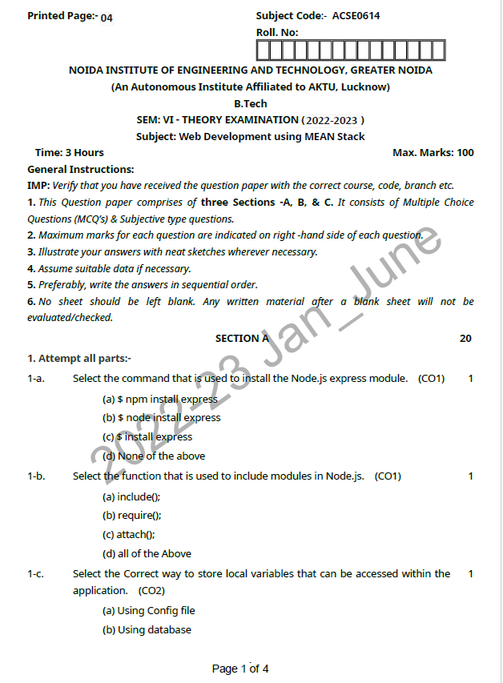
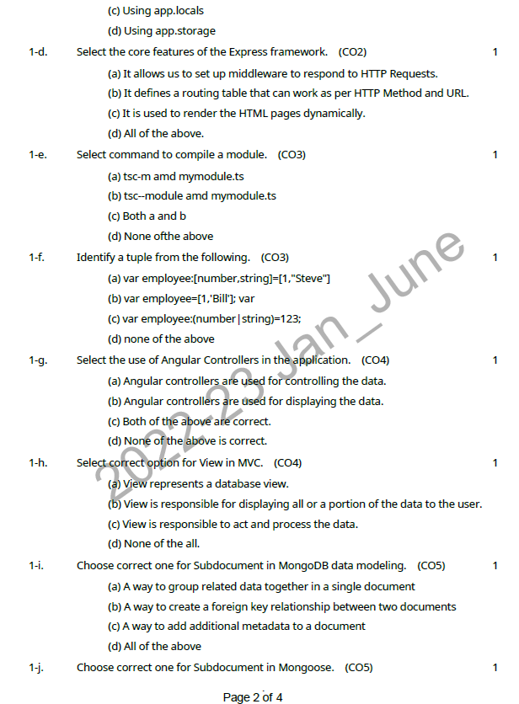
Previous Year Question paper

Slide 62
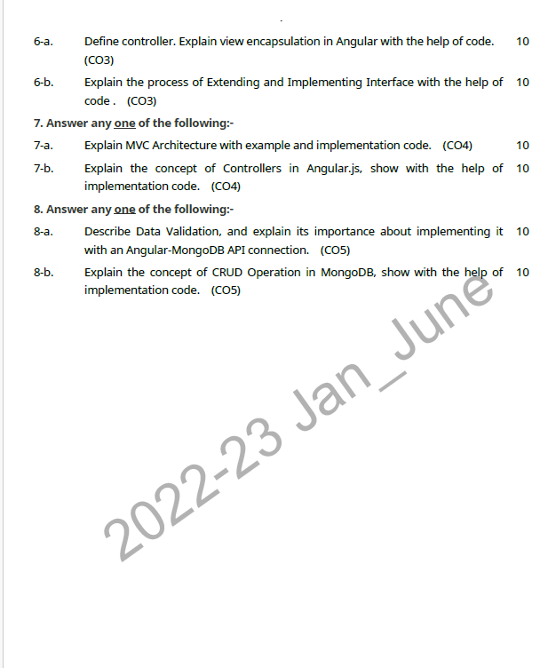
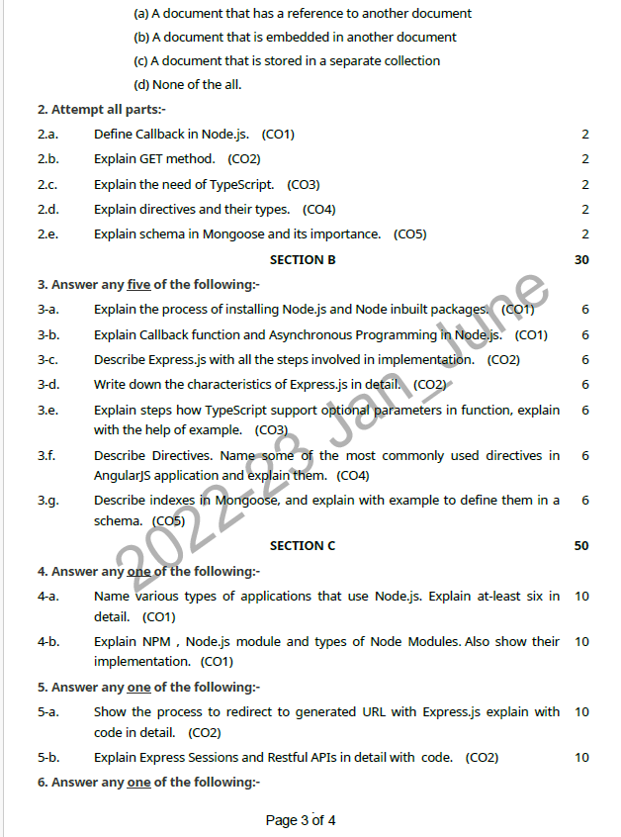
Previous Year Question paper(Contd…)

Slide 63
Glossary Questions
Top 10 design pattern interview questions
Discuss data modeling in MongoDB, and how does it differ from traditional relational database modeling.
Explain the key considerations for data modeling in MongoDB.
Describe some best practices for choosing between SQL and NoSQL databases.
Differences between SQL and NoSQL databases.
Explain NoSQL land scape and state some common types of NoSQL databases.

Slide 64
Expected Questions for University Exam
Explain method to create a new collection in MongoDB.
Illustrate the default size of a new collection in MongoDB.
Explain custom size for a new collection in MongoDB.
Explain purpose of the capped collection in MongoDB.
Explain how to perform an aggregation operation in MongoDB using the aggregate() method?
Explain pipeline in MongoDB aggregation, and how does it work.
Describe how to use $group operator in MongoDB aggregation to group documents by a certain field.
Explain $sum operator in MongoDB aggregation, and how is it used to calculate totals.

Slide 65
Summary
Till Now we understand, MongoDB, How can we install Mongodb application. How Data modelling works, Create Collection in MongoDB . How can we use CURD operation in MongoDB. Mongo’s Features set .Introduction of Mongoose
Understanding mongoose Schema and data types

Slide 66
References
Simon Holmes, Clive Herber, “Getting MEAN with Mongo, Express, Angular, and Node”, 2nd Edition 2016, Addison Wesley Publication.
Dhruti Shah, “Comprehensive guide to learn Node.js”, 1st Edition, 2018 BPB Publications.
Christoffer,Noring,Pablo,Deeleman,“Learning Angular”,3rd Edition,2017 Packt publications. .
Peter Membrey, David Hows, Eelco Plugge, “MongoDB Basics”, 2nd edition, 2018, International Publication.
Christoffer Noring, Pablo Deeleman, “Learning Angular”,3rd Edition,

Slide 67
THANK YOU

